Slide 1

Government Customer Behavior Segmentation
Autumn Li
10/3/2019

Slide 2


Why segmentation?
Customers are unique and have different marketing requirements
Marketing strategies fail to recognize said fact will lead to a scatter gun approach and dilute the marketing efforts
Segmentation

Slide 3
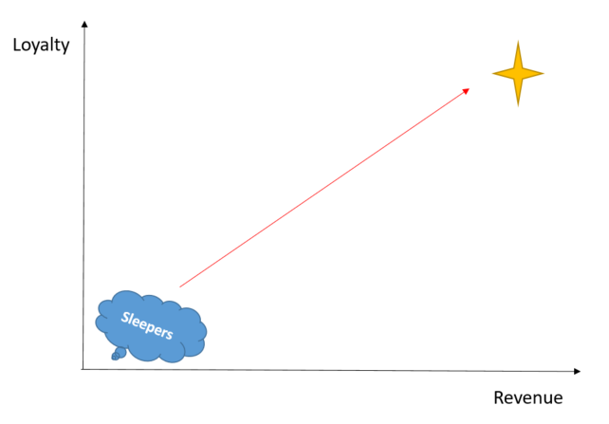
Segmentation Benefits
Lead to a closer matching of customer’s needs with company’s products and service
Different allocation on the marketing campaign events for customers migration and new products launch

Slide 4
Segmentation Process Overview
High Revenue Loyal
Engaged and Varied
New and Powerful
Small with Potential
Sleepers
Raw Data
Variable Creation
Cluster Analysis
5 Segments

Slide 5
Raw Data Population Waterfall
All Government Vertical
(11,573 Subaccounts)
Drop attrited subaccounts
4,847
Drop outliers
235
Qualified subaccounts
6,491
Notes:
For government, there are 11,573 subaccounts, we need to drop 4,847 attrited subaccounts, then we also need to drop 235 outliers, then the final qualified subaccounts for further cluster analysis is 6,491.
Attrited means: where v.vertical_market_gen01 in ('GOVERNMENT RISK') and ca.cy_vertical_sk in (7,8,9,54,55) and ca.hh_id not in (0) and ca.subaccount_attrition_year_month < 1 and ca.src_cancel_dt <= 0
and ca.subaccount_status = 'Active'
Outliers means: subaccounts have high revenue and 0 usages… There are 235 accounts have high revenue(greater than the overall median revenues) and 0 usages

Slide 6
Raw Data
29 sub-markets
54 Products
3,486 search types
6,726 qualified accounts
6 delivery types
80 customer service types

Slide 7
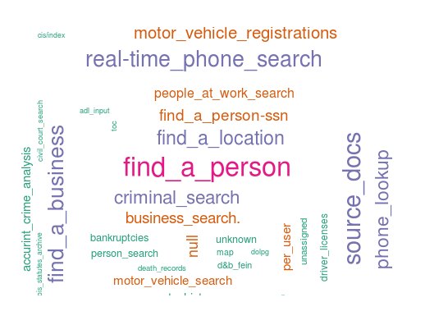
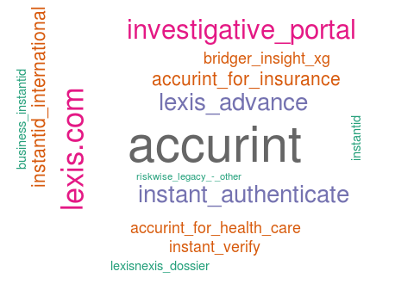
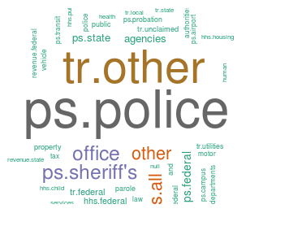
Raw Data
Product Name
Search Types
Sub-markets
Notes:
Here is the word cloud map for frequencies of search type, product names and sub markets. Big fonts means high frequencies, and small fonts means low frequencies. All the colors are assigned automatically. As you can see, we have very rich raw data, we need to find out a way to measure our customers’ behavior better

Slide 8
Behavioral Variable Creation
Behavioral Variables
Customer Age
Key Performance
Total searches in past 6 months Total revenue in past 6 months
Days on books; Days since earliest search
Active Customers
Growth Potential
Year over year revenue growth
Number of active users in past 6 months
Customer Service
Sum customer service password Sum customer service billing
Product Stickiness
Number of distinct search types Number of distinct delivery type Number of distinct products
There are 56 behavior variables used for cluster analysis
Notes:
Here is how I created of the behavioral variables，I categorize behavior variables into 6 measurements, you can see them in 6 square box, under each box are one or two examples for its categories. For example, days on books and days since earliest search are two examples to measure customer age, total searches in the past 6 months and total revenue in the past 6 months to measure key performance and so forth

Slide 9
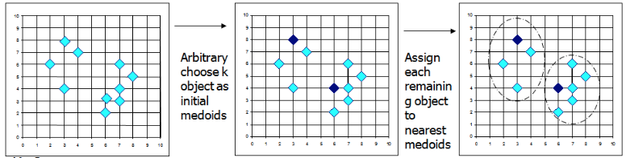
Segmentation: Cluster Analysis
PAM algorithm
The PAM (Partitioning Around Medoids) is a clustering algorithm to partition the dataset into k groups, and attempt to minimize the distance between data points and the nearest medoids (the center of that cluster)
Choose K groups as initial medoids
Assign data points to nearest medoids
K= 2

Slide 10
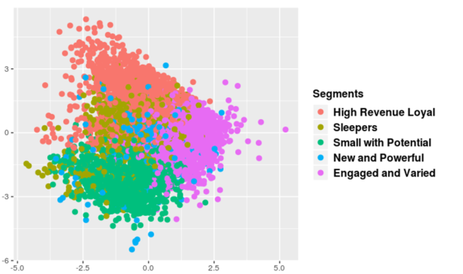
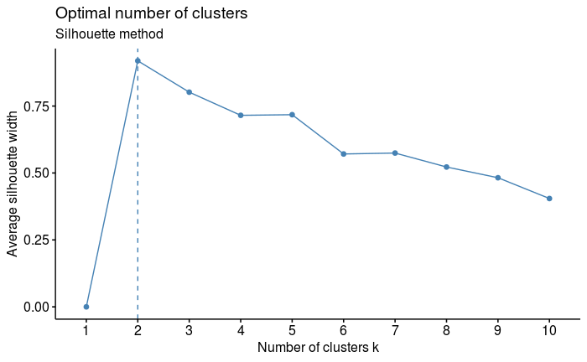
Segmentation: Cluster Analysis
The silhouette score ranges from −1 to +1, where a high value indicates that data points are well matched to its own cluster
Notes:
In statistics, we use silhouette scores to determine the optimal number of the clustering. The silhouette score ranges from −1 to +1, where a high value indicates that data points are well matched to its own cluster. From the left graph, as you can see the when number of clusters K=2 has the highest silhouette scores, but this is a expected phenomenon sine it is the starting of the clustering. The silhouette scores will start going down when there is more devided groups. However, please pay attention to K =5, the silhouette scores goes up a little bit, we call this point as elbow point, thus we determine optimal number of clusters is 5.

Slide 11
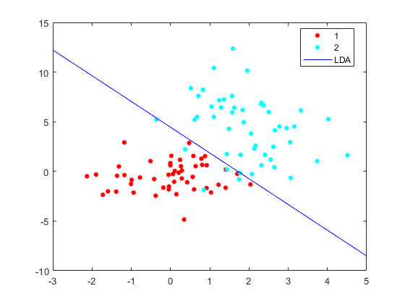
Segmentation: Cluster Analysis
After determining number of clusters, the next step is to perform Linear Discriminant Analysis to characterize each cluster
Linear Discriminant Analysis, is linear classification boundaries used in statistics to find combination of features that characterizes or separates two or more clusters of datasets

Slide 12
Segmentation: Cluster Analysis
## Proportion of trace: ## LD1 LD2 LD3 LD4 ## 0.6163 0.1600 0.1504 0.0733
Based on these 4 linear discriminant linear boundaries, we can calculate discriminant scores for each clusters
Notes:
These 4 linear boundaries are ale to define the different characters of 5 distinct clusters.

Slide 13
Segmentation: Cluster Analysis
How to assign new observations to a certain cluster ?
Calculate discriminant scores of each clusters
Calculate discriminant scores of new observations
Then calculate the geometrical distances between new observation scores and cluster discriminant scores
Finally assign new observation to the cluster that is closest in geometrical space
The closest cluster

Slide 14
Segmentation Descriptive Details

Slide 15
Segmentation Descriptive Details
Appendix for rank of average values by segments
Appendix

Slide 16
Government Sub-market by Segments
Appendix for percentages

Slide 17
Government Tier by Segments
Appendix for percentages

Slide 18
Appendix

Slide 19
Appendix
Segmentation Descriptive Details
BACK

Slide 20
Government Sub-Market by Segments
Appendix
BACK

Slide 21
Government Tier by Segments
Appendix
BACK

Slide 22

Data Preparation before Cluster Analysis
Appendix
6,726 subaccounts with 56 behavior variables
Replace missing value with 0
Replace 1.1% extreme values
Clustering
Take out 235 customers have high revenue but 0 usage
6491 subaccounts with 72 behavior variables

